Slide 1
Cs1231S T02 tutorial #5
Mathematical Induction
You may ask me questions about Assignment 1 before the class starts (and at other times outside class).

Slide 2
Learning objectives of this tutorial
understanding Mathematical Induction (MI)
using MI and Strong MI in proofs
recursive definition of a sequence
recursive definition of a set
using structural induction over recursively defined sets

Slide 3
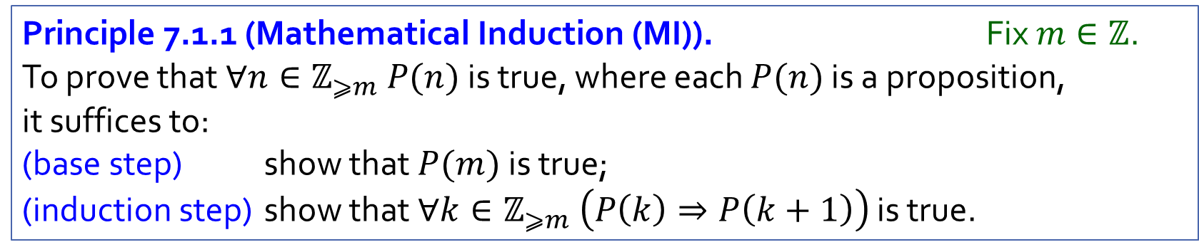
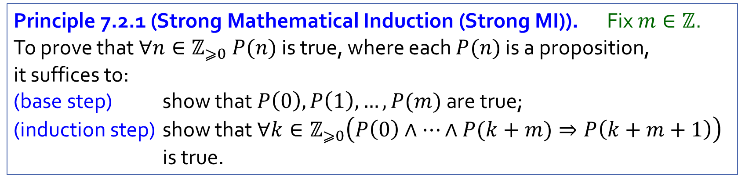
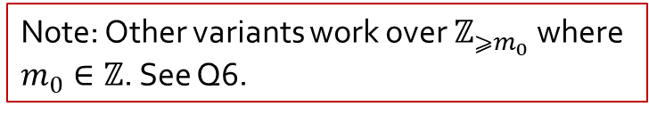
Recap
Note: Other variants work over $ℤ_{{⩾m}_{0}}$ where $m_{0}∈ℤ$. See Q6.
Principle 7.1.1 (Mathematical Induction (MI)). Fix $m∈ℤ$.
To prove that $∀n∈ℤ_{⩾m} P(n)$ is true, where each $P(n)$ is a proposition, it suffices to:
(base step) show that $P(m)$ is true;
(induction step) show that $∀k∈ℤ_{⩾m} \left(P\left(k\right)⇒P\left(k+1\right)\right)$ is true.
Principle 7.2.1 (Strong Mathematical Induction (Strong MI)). Fix $m∈ℤ$.
To prove that $∀n∈ℤ_{⩾0} P(n)$ is true, where each $P(n)$ is a proposition, it suffices to:
(base step) show that $P\left(0\right),P\left(1\right),…,P(m)$ are true;
(induction step) show that $∀k∈ℤ_{⩾0}\left(P\left(0\right)∧⋯∧P(k+m)⇒P\left(k+m+1\right)\right)$ is true.

Slide 4
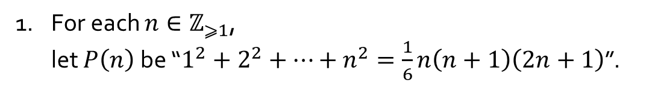


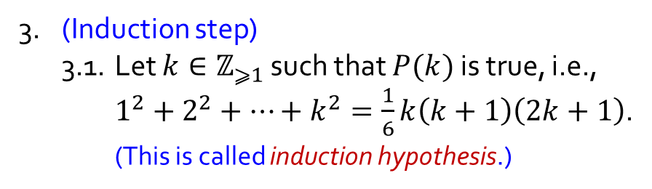
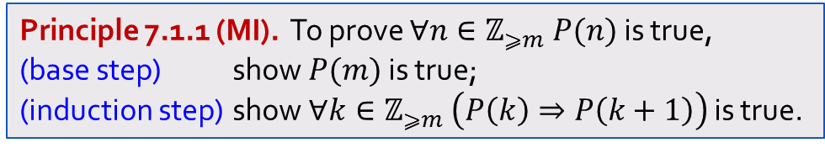
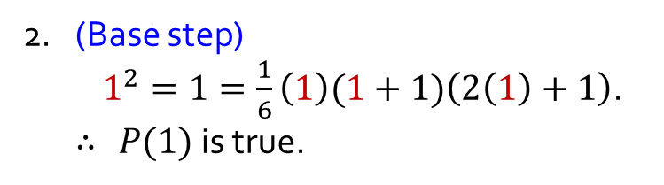

Q1.
Prove: $∀n∈ℤ_{⩾1} 1^{2}+2^{2}+⋯+n^{2}=\frac{1}{6}n(n+1)(2n+1)$.
Principle 7.1.1 (MI). To prove $∀n∈ℤ_{⩾m} P(n)$ is true,
(base step) show $P(m)$ is true;
(induction step) show $∀k∈ℤ_{⩾m} \left(P\left(k\right)⇒P\left(k+1\right)\right)$ is true.
1. For each $n∈ℤ_{⩾1}$,
let $P\left(n\right)$ be “$1^{2}+2^{2}+⋯+n^{2}=\frac{1}{6}n\left(n+1\right)\left(2n+1\right)$”.
3.2. Then
$1^{2}+2^{2}+⋯+k^{2}+{(k+1)}^{2}$
$=\frac{1}{6}\left(k+1\right)((k+1)+1)(2(k+1)+1)$.
2. (Base step)
$1^{2}=1=\frac{1}{6}\left(1\right)(1+1)\left(2\left(1\right)+1\right)$.
$∴$ $P(1)$is true.
3. (Induction step)
3.1. Let $k∈ℤ_{⩾1}$ such that $P(k)$is true, i.e.,
$1^{2}+2^{2}+⋯+k^{2}=\frac{1}{6}k\left(k+1\right)\left(2k+1\right)$.
(This is called induction hypothesis.)
3.3. So $P(k+1)$ is true.
4. Hence $∀n∈ℤ_{⩾1} P(n)$ is true by MI.

Slide 5
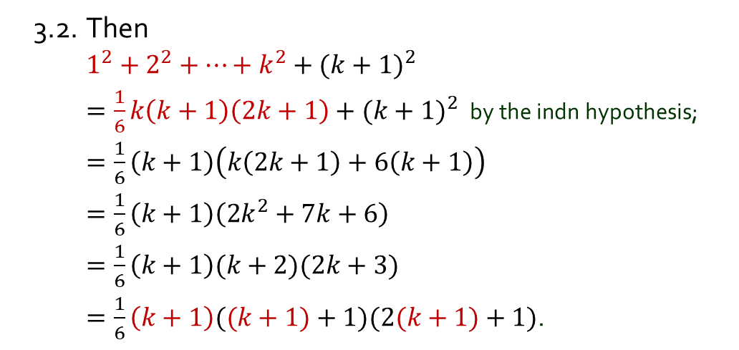
Q1.
Prove: $∀n∈ℤ_{⩾1} 1^{2}+2^{2}+⋯+n^{2}=\frac{1}{6}n(n+1)(2n+1)$.
Principle 7.1.1 (MI). To prove $∀n∈ℤ_{⩾m} P(n)$ is true,
(base step) show $P(m)$ is true;
(induction step) show $∀k∈ℤ_{⩾m} \left(P\left(k\right)⇒P\left(k+1\right)\right)$ is true.
1. For each $n∈ℤ_{⩾1}$,
let $P\left(n\right)$ be “$1^{2}+2^{2}+⋯+n^{2}=\frac{1}{6}n\left(n+1\right)\left(2n+1\right)$”.
3.2. Then
$1^{2}+2^{2}+⋯+k^{2}+{(k+1)}^{2}$
$=\frac{1}{6}k\left(k+1\right)\left(2k+1\right)+{(k+1)}^{2}$ by the indn hypothesis;
$=\frac{1}{6}\left(k+1\right)\left(k\left(2k+1\right)+6\left(k+1\right)\right)$
$=\frac{1}{6}\left(k+1\right)\left(2k^{2}+7k+6\right)$
$=\frac{1}{6}\left(k+1\right)(k+2)(2k+3)$
$=\frac{1}{6}\left(k+1\right)((k+1)+1)(2(k+1)+1)$.
2. (Base step)
$1^{2}=1=\frac{1}{6}\left(1\right)(1+1)\left(2\left(1\right)+1\right)$.
$∴$ $P(1)$is true.
3. (Induction step)
3.1. Let $k∈ℤ_{⩾1}$ such that $P(k)$is true, i.e.,
$1^{2}+2^{2}+⋯+k^{2}=\frac{1}{6}k\left(k+1\right)\left(2k+1\right)$.
(This is called induction hypothesis.)
3.3. So $P(k+1)$ is true.
4. Hence $∀n∈ℤ_{⩾1} P(n)$ is true by MI.

Slide 6

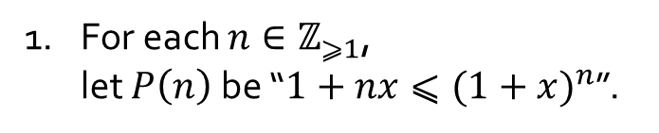

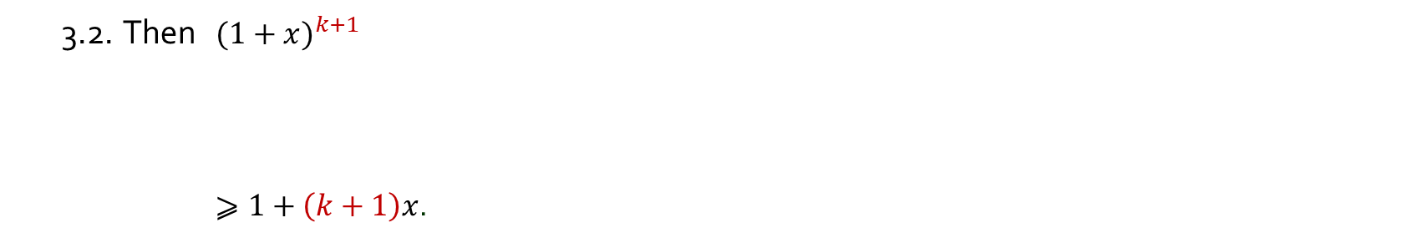
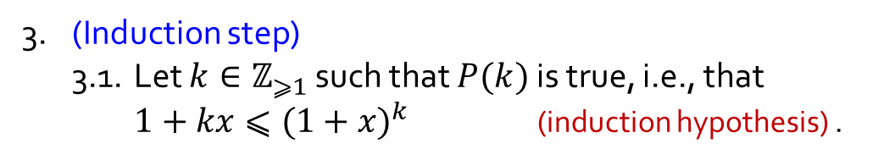
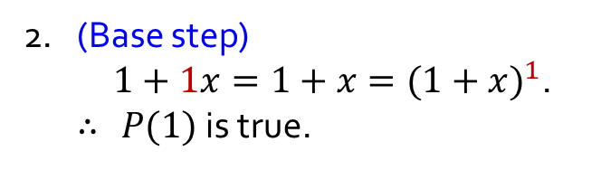
Q2.
Let $x∈ℝ_{⩾−1}$. Prove: $∀n∈ℤ_{⩾1} 1+nx⩽{(1+x)}^{n}.$
1. For each $n∈ℤ_{⩾1}$,
let $P\left(n\right)$ be “$1+nx⩽{(1+x)}^{n}$”.
Principle 7.1.1 (MI). To prove $∀n∈ℤ_{⩾m} P(n)$ is true,
(base step) show $P(m)$ is true;
(induction step) show $∀k∈ℤ_{⩾m} \left(P\left(k\right)⇒P\left(k+1\right)\right)$ is true.
2. (Base step)
$1+1x=1+x={(1+x)}^{1}$.
$∴$ $P(1)$is true.
3. (Induction step)
3.1. Let $k∈ℤ_{⩾1}$ such that $P(k)$is true, i.e., that
$1+kx⩽{(1+x)}^{k}$ (induction hypothesis) .
3.2. Then ${(1+x)}^{k+1}$
$⩾1+\left(k+1\right)x$.
3.3. So $P(k+1)$ is true.
4. Hence $∀n∈ℤ_{⩾1} P(n)$ is true by MI.

Slide 7
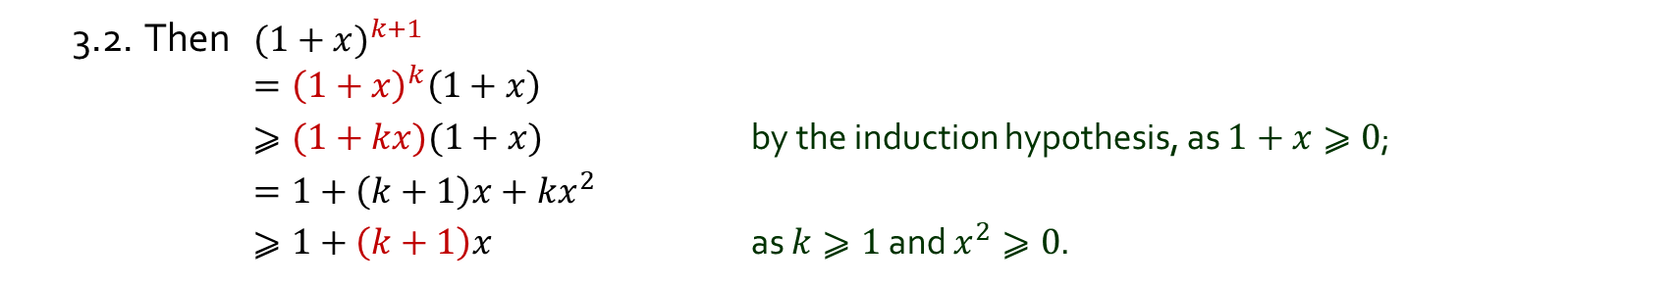
Q2.
Let $x∈ℝ_{⩾−1}$. Prove: $∀n∈ℤ_{⩾1} 1+nx⩽{(1+x)}^{n}.$
1. For each $n∈ℤ_{⩾1}$,
let $P\left(n\right)$ be “$1+nx⩽{(1+x)}^{n}$”.
Principle 7.1.1 (MI). To prove $∀n∈ℤ_{⩾m} P(n)$ is true,
(base step) show $P(m)$ is true;
(induction step) show $∀k∈ℤ_{⩾m} \left(P\left(k\right)⇒P\left(k+1\right)\right)$ is true.
2. (Base step)
$1+1x=1+x={(1+x)}^{1}$.
$∴$ $P(1)$is true.
3. (Induction step)
3.1. Let $k∈ℤ_{⩾1}$ such that $P(k)$is true, i.e., that
$1+kx⩽{(1+x)}^{k}$ (induction hypothesis) .
3.2. Then ${(1+x)}^{k+1}$
$={\left(1+x\right)}^{k}\left(1+x\right)$
$⩾(1+kx)(1+x)$ by the induction hypothesis, as $1+x⩾0$;
$=1+\left(k+1\right)x+kx^{2}$
$⩾1+\left(k+1\right)x$ as $k⩾1$ and $x^{2}⩾0$.
3.3. So $P(k+1)$ is true.
4. Hence $∀n∈ℤ_{⩾1} P(n)$ is true by MI.

Slide 8
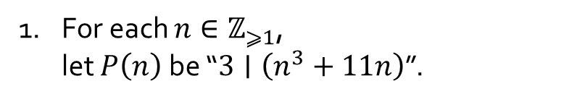

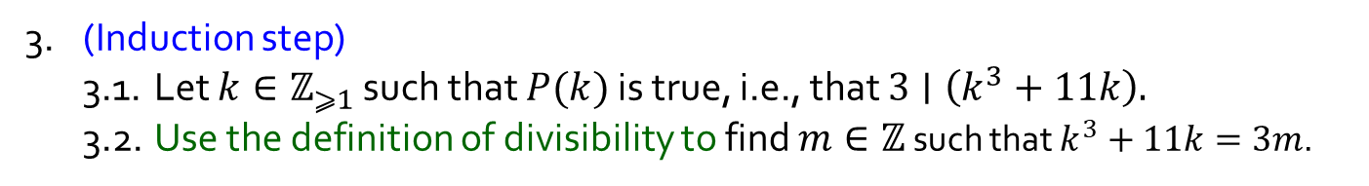
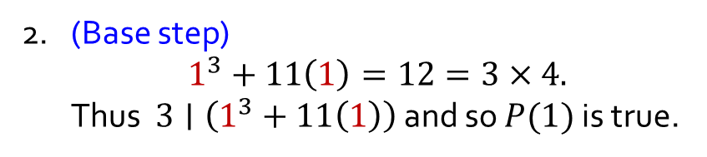

Q3.
Prove: $∀n∈ℤ_{⩾1} 3∣(n^{3}+11n)$.
1. For each $n∈ℤ_{⩾1}$,
let $P\left(n\right)$ be “$3∣\left(n^{3}+11n\right)$”.
Principle 7.1.1 (MI). To prove $∀n∈ℤ_{⩾m} P(n)$ is true,
(base step) show $P(m)$ is true;
(induction step) show $∀k∈ℤ_{⩾m} \left(P\left(k\right)⇒P\left(k+1\right)\right)$ is true.
2. (Base step)
$1^{3}+11\left(1\right)=12=3×4.$
Thus $3∣\left(1^{3}+11\left(1\right)\right)$ and so $P(1)$is true.
3. (Induction step)
3.1. Let $k∈ℤ_{⩾1}$ such that $P(k)$is true, i.e., that $3∣\left(k^{3}+11k\right).$
3.2. Use the definition of divisibility to find $m∈ℤ$ such that $k^{3}+11k=3m$.
3.4. Thus $3∣\left({\left(k+1\right)}^{3}+11(k+1)\right)$ and so $P(k+1)$ is true.
4. Hence $∀n∈ℤ_{⩾1} P(n)$ is true by MI.
$$d∣n ⇔ ∃k∈ℤ \left(n=dk\right).$$

Slide 9
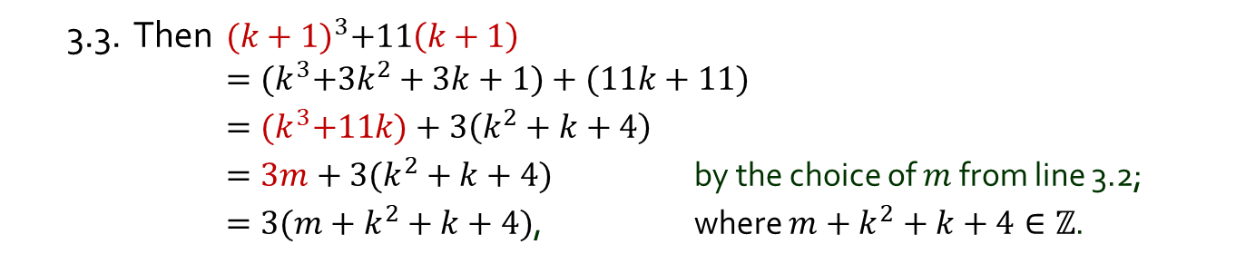
Q3.
Prove: $∀n∈ℤ_{⩾1} 3∣(n^{3}+11n)$.
1. For each $n∈ℤ_{⩾1}$,
let $P\left(n\right)$ be “$3∣\left(n^{3}+11n\right)$”.
Principle 7.1.1 (MI). To prove $∀n∈ℤ_{⩾m} P(n)$ is true,
(base step) show $P(m)$ is true;
(induction step) show $∀k∈ℤ_{⩾m} \left(P\left(k\right)⇒P\left(k+1\right)\right)$ is true.
2. (Base step)
$1^{3}+11\left(1\right)=12=3×4.$
Thus $3∣\left(1^{3}+11\left(1\right)\right)$ and so $P(1)$is true.
3. (Induction step)
3.1. Let $k∈ℤ_{⩾1}$ such that $P(k)$is true, i.e., that $3∣\left(k^{3}+11k\right).$
3.2. Use the definition of divisibility to find $m∈ℤ$ such that $k^{3}+11k=3m$.
3.3. Then ${(k+1)}^{3}+11\left(k+1\right)$
$={(k}^{3}+3k^{2}+3k+1)+(11k+11)$
$={(k}^{3}+11k)+3\left(k^{2}+k+4\right)$
$=3m+3(k^{2}+k+4)$ by the choice of $m$ from line 3.2;
$=3(m+k^{2}+k+4)$, where $m+k^{2}+k+4∈ℤ$.
3.4. Thus $3∣\left({\left(k+1\right)}^{3}+11(k+1)\right)$ and so $P(k+1)$ is true.
4. Hence $∀n∈ℤ_{⩾1} P(n)$ is true by MI.
$$d∣n ⇔ ∃k∈ℤ \left(n=dk\right).$$

Slide 10

Q4.
Let $a$ be an odd integer. Prove: $∀n∈ℤ_{⩾1} 2^{n+2}∣(a^{2^{n}}−1).$
1. Use the definition of “odd” to find $p∈ℤ$ such that $a=2p+1$.
2. For each $n∈ℤ_{⩾1}$, let $P\left(n\right)$ be “$2^{n+2}∣(a^{2^{n}}−1)$”.
3. (Base step)
3.1. $a^{2^{1}}−1=$
3.5. Thus $2^{1+2}=8∣{(a}^{2^{1}}−1)$.
3.6. So $P(1)$ is true.
4. (Induction step)
Let $k∈ℤ_{⩾1}$ such that $P(k)$ is true. … … So $P(k+1)$ is true.
5. Hence $∀n∈ℤ_{⩾1} P\left(n\right)$ is true by MI.
$$d∣n ⇔ ∃k∈ℤ \left(n=dk\right).$$

Slide 11
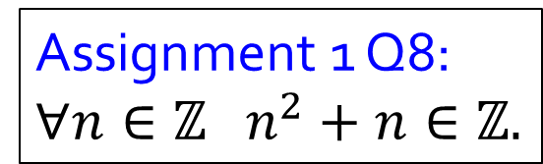
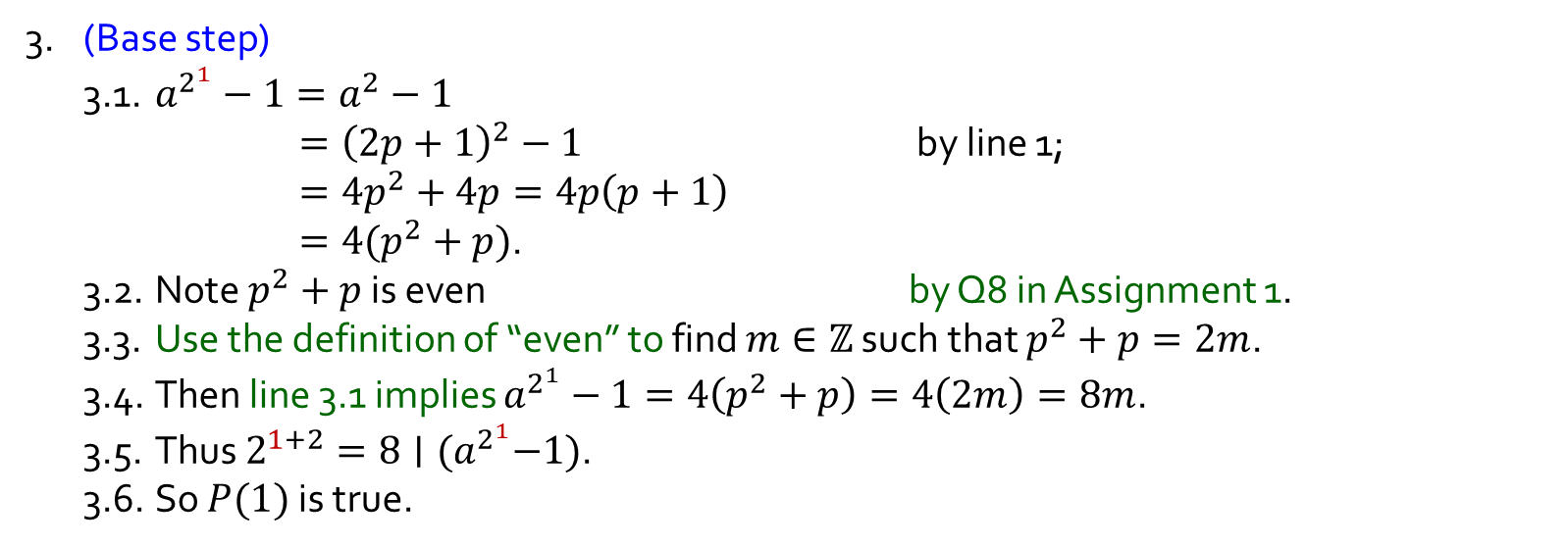
Q4.
Let $a$ be an odd integer. Prove: $∀n∈ℤ_{⩾1} 2^{n+2}∣(a^{2^{n}}−1).$
1. Use the definition of “odd” to find $p∈ℤ$ such that $a=2p+1$.
2. For each $n∈ℤ_{⩾1}$, let $P\left(n\right)$ be “$2^{n+2}∣(a^{2^{n}}−1)$”.
3. (Base step)
3.1. $a^{2^{1}}−1=a^{2}−1$
$={\left(2p+1\right)}^{2}−1$ by line 1;
$=4p^{2}+4p=4p\left(p+1\right)$
$=4(p^{2}+p)$.
3.2. Note $p^{2}+p$ is even by Q8 in Assignment 1.
3.3. Use the definition of “even” to find $m∈ℤ$ such that $p^{2}+p=2m$.
3.4. Then line 3.1 implies $a^{2^{1}}−1=4\left(p^{2}+p\right)=4\left(2m\right)=8m$.
3.5. Thus $2^{1+2}=8∣{(a}^{2^{1}}−1)$.
3.6. So $P(1)$ is true.
Assignment 1 Q8: $∀n∈ℤ n^{2}+n∈ℤ.$
4. (Induction step)
Let $k∈ℤ_{⩾1}$ such that $P(k)$ is true. … … So $P(k+1)$ is true.
5. Hence $∀n∈ℤ_{⩾1} P\left(n\right)$ is true by MI.
$$d∣n ⇔ ∃k∈ℤ \left(n=dk\right).$$

Slide 12

Q4.
Let $a$ be an odd integer. Prove: $∀n∈ℤ_{⩾1} 2^{n+2}∣(a^{2^{n}}−1).$
1. Use the definition of “odd” to find $p∈ℤ$ such that $a=2p+1$.
2. For each $n∈ℤ_{⩾1}$, let $P\left(n\right)$ be “$2^{n+2}∣(a^{2^{n}}−1)$”.
3. (Base step) … … So $P(1)$ is true.
4. (Induction step)
4.1. Let $k∈ℤ_{⩾1}$ such that $P(k)$ is true, i.e., that $2^{k+2}∣(a^{2^{k}}−1).$
4.2. Use the definition of divisibility to find $m∈ℤ$ such that $a^{2^{k}}−1=2^{k+2}m$.
4.3. $a^{2^{k+1}}−1=a^{2^{k}×2}−1={\left(a^{2^{k}}\right)}^{2}−1$
$={\left((a^{2^{k}}−1)+1\right)}^{2}−1$
$={\left(2^{k+2}m+1\right)}^{2}−1$ by line 4.2;
$=\left({\left(2^{k+2}m\right)}^{2}+2×2^{\left(k+2\right)}m+1\right)−1$
$=2^{2k+4}m^{2}+2^{k+3}m$
$=2^{k+3}\left(2^{k+1}m^{2}+m\right)$, where $2^{k+1}m^{2}+m∈ℤ$.
4.4. Then $2^{(k+1)+2}∣(a^{2^{k+1}}−1$) and so $P(k+1)$is true.
5. Hence $∀n∈ℤ_{⩾1} P(n)$ is true by MI.
$$d∣n ⇔ ∃k∈ℤ \left(n=dk\right).$$

Slide 13
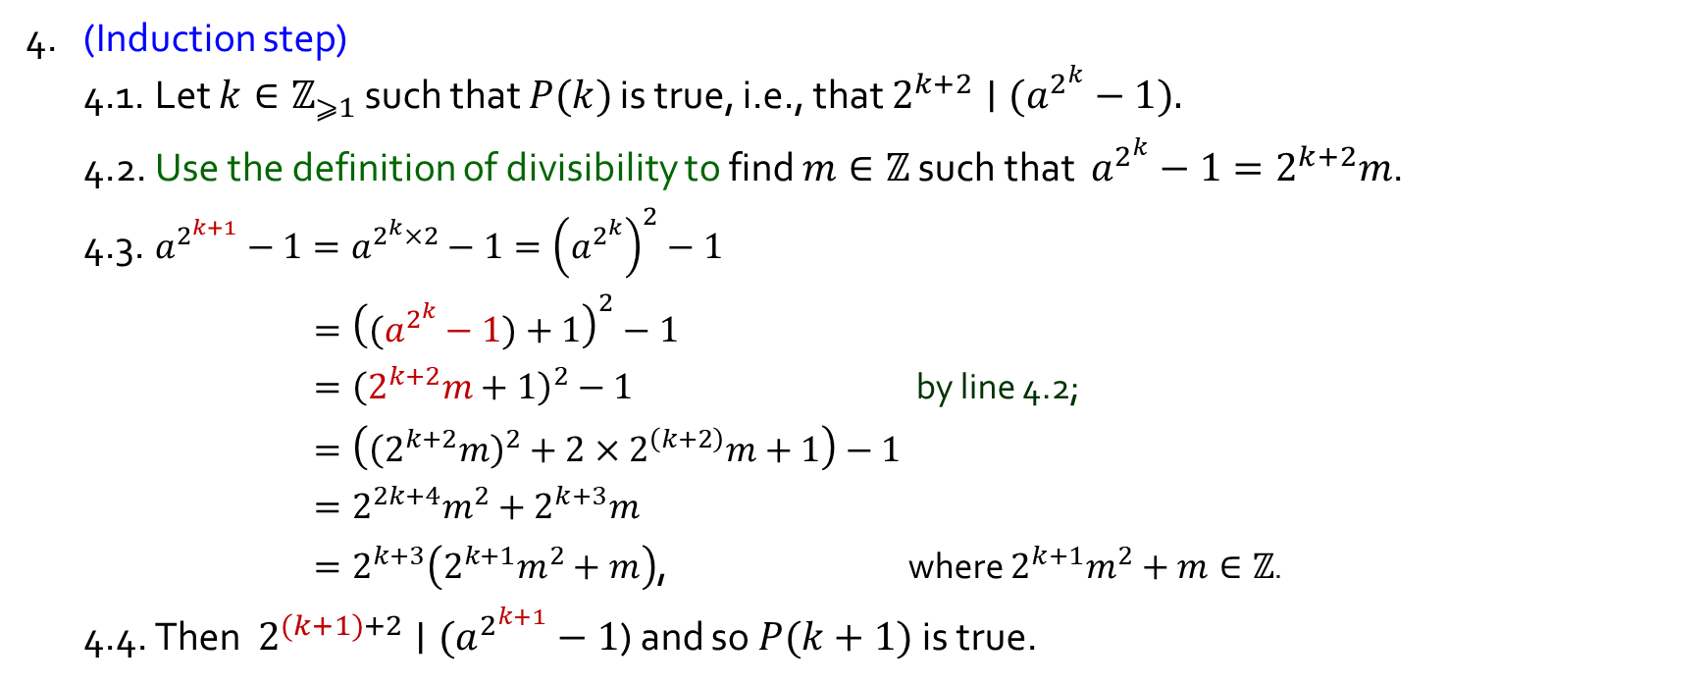
Q4.
Let $a$ be an odd integer. Prove: $∀n∈ℤ_{⩾1} 2^{n+2}∣(a^{2^{n}}−1).$
1. Use the definition of “odd” to find $p∈ℤ$ such that $a=2p+1$.
2. For each $n∈ℤ_{⩾1}$, let $P\left(n\right)$ be “$2^{n+2}∣(a^{2^{n}}−1)$”.
3. (Base step) … … So $P(1)$ is true.
4. (Induction step)
4.1. Let $k∈ℤ_{⩾1}$ such that $P(k)$ is true, i.e., that $2^{k+2}∣(a^{2^{k}}−1).$
4.2. Use the definition of divisibility to find $m∈ℤ$ such that $a^{2^{k}}−1=2^{k+2}m$.
4.3. $a^{2^{k+1}}−1=a^{2^{k}×2}−1={\left(a^{2^{k}}\right)}^{2}−1$
$={\left((a^{2^{k}}−1)+1\right)}^{2}−1$
$={\left(2^{k+2}m+1\right)}^{2}−1$ by line 4.2;
$=\left({\left(2^{k+2}m\right)}^{2}+2×2^{\left(k+2\right)}m+1\right)−1$
$=2^{2k+4}m^{2}+2^{k+3}m$
$=2^{k+3}\left(2^{k+1}m^{2}+m\right)$, where $2^{k+1}m^{2}+m∈ℤ$.
4.4. Then $2^{(k+1)+2}∣(a^{2^{k+1}}−1$) and so $P(k+1)$is true.
5. Hence $∀n∈ℤ_{⩾1} P(n)$ is true by MI.
$$d∣n ⇔ ∃k∈ℤ \left(n=dk\right).$$

Slide 14



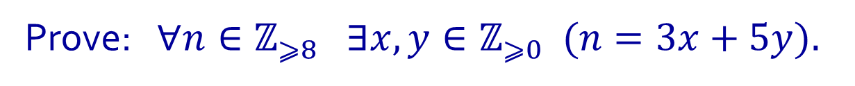
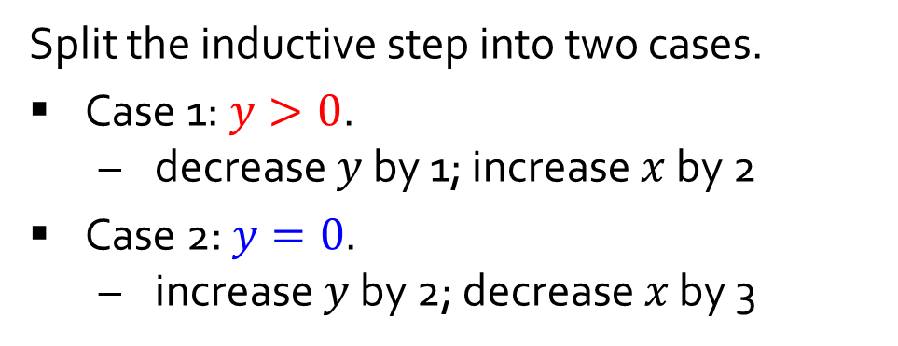


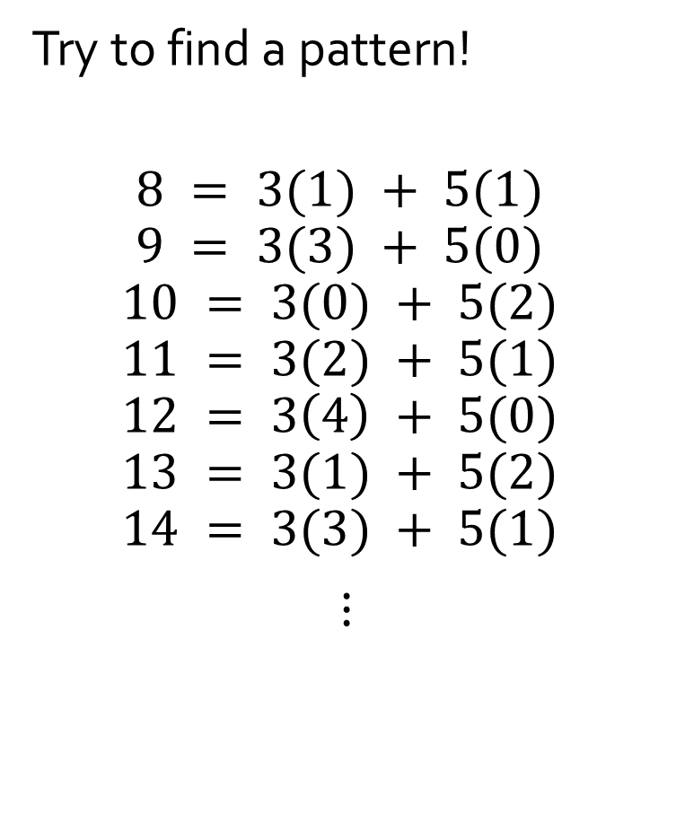








Q5.
Prove: $∀n∈ℤ_{⩾8} ∃x,y∈ℤ_{⩾0} (n=3x+5y).$
Try to find a pattern!
$$8 = 3(1) + 5(1)$$
$$9 = 3(3) + 5(0)$$
$$10 = 3(0) + 5(2)$$
$$11 = 3(2) + 5(1)$$
$$12 = 3\left(4\right) + 5(0)$$
$$13 = 3(1) + 5(2)$$
$$14 = 3(3) + 5(1)$$
$⋮$
Split the inductive step into two cases.
Case 1: $y>0$.
decrease $y$ by 1; increase $x$ by 2
Case 2: $y=0$.
increase $y$ by 2; decrease $x$ by 3
$$+2$$
$$−1$$
$$−3$$
$$+2$$
$$+2$$
$$−1$$
$$+2$$
$$−1$$
$$−3$$
$$+2$$
$$+2$$
$$−1$$

Slide 15
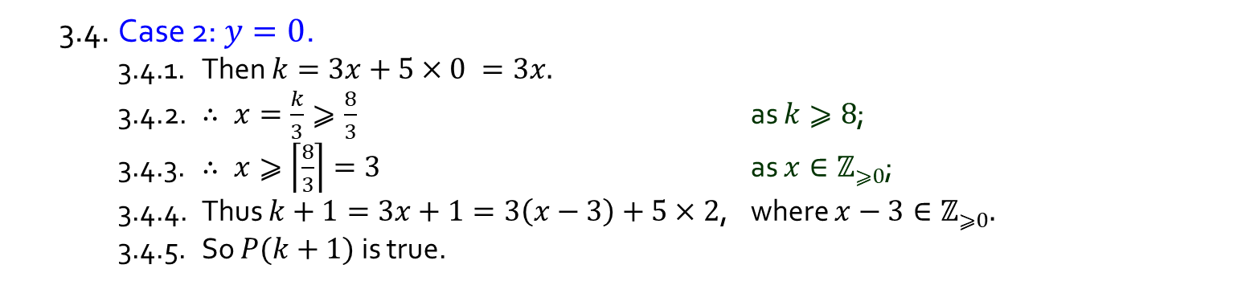


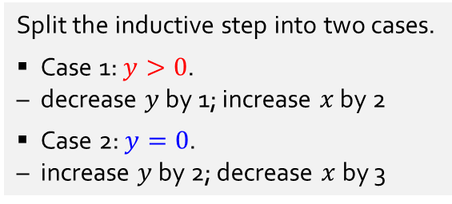
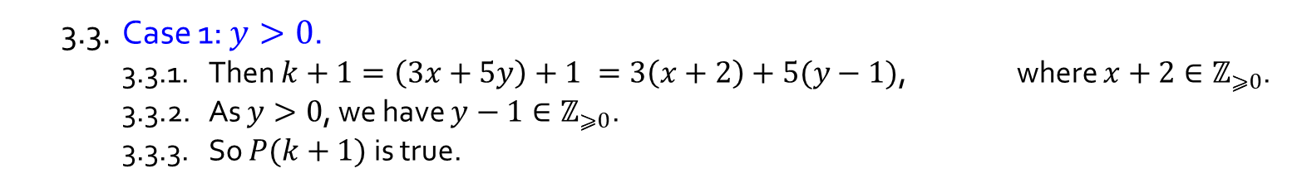
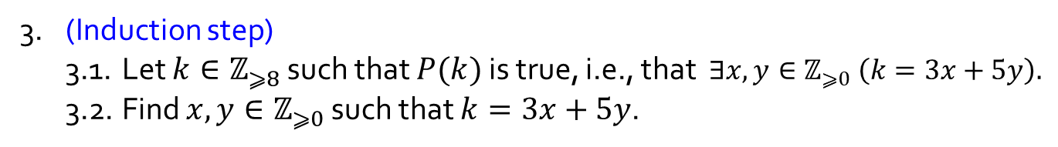
Q5.
Prove: $∀n∈ℤ_{⩾8} ∃x,y∈ℤ_{⩾0} (n=3x+5y).$
1. For each $n∈ℤ_{⩾8}$, let $P\left(n\right)$ be “$∃x,y∈ℤ_{⩾0} (n=3x+5y)$”.
2. (Base step) $P(8)$is true as $8=3×1+5×1.$
3. (Induction step)
3.1. Let $k∈ℤ_{⩾8}$ such that $P(k)$is true, i.e., that $∃x,y∈ℤ_{⩾0} \left(k=3x+5y\right).$
3.2. Find $x,y∈ℤ_{⩾0}$ such that $k=3x+5y$.
3.3. Case 1: $y>0$.
3.3.1. Then $k+1=\left(3x+5y\right)+1 =3\left(x+2\right)+5(y−1)$, where $x+2∈ℤ_{⩾0}$.
3.3.2. As $y>0$, we have $y−1∈ℤ_{⩾0}\text{.}$
3.3.3. So $P(k+1)$ is true.
Split the inductive step into two cases.
Case 1: $y>0$.
decrease $y$ by 1; increase $x$ by 2
Case 2: $y=0$.
increase $y$ by 2; decrease $x$ by 3
3.4. Case 2: $y=0$.
3.4.1. Then $k=3x+5×0 =3x.$
3.4.2. $∴ x=\frac{k}{3}⩾\frac{8}{3}$ as $k⩾8$;
3.4.3. $∴ x⩾\left\lceil \frac{8}{3}\right\rceil =3$ as $x∈ℤ_{⩾0}$;
3.4.4. Thus $k+1=3x+1=3\left(x−3\right)+5×2$, where $x−3∈ℤ_{⩾0}.$
3.4.5. So $P(k+1)$ is true.
3.5. Thus $P(k+1)$ is true in all cases.
4. Hence $∀n∈ℤ_{⩾8} P(n)$ is true by MI.

Slide 16
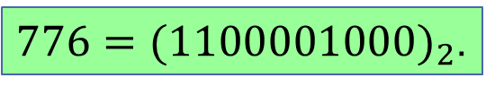
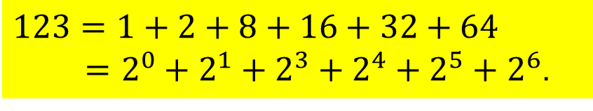
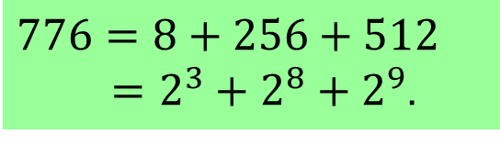
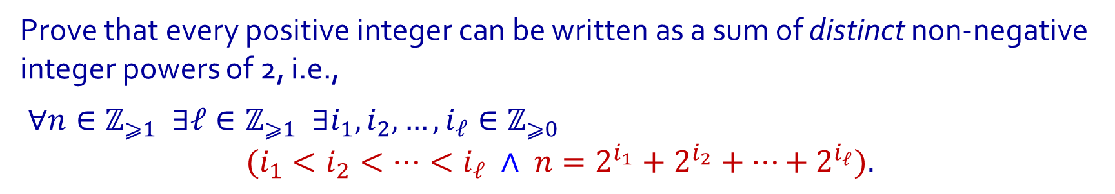
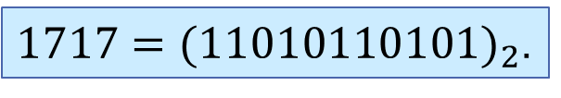
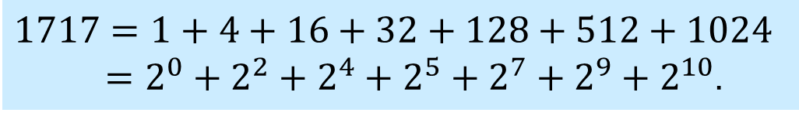
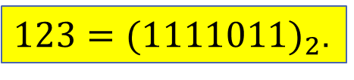
Q6.
Prove that every positive integer can be written as a sum of distinct non-negative integer powers of 2, i.e.,
$∀n∈ℤ_{⩾1} ∃ℓ∈ℤ_{⩾1} ∃i_{1},i_{2}, …,i_{ℓ}∈ℤ_{⩾0}$
$$(i_{1}<i_{2}<⋯<i_{ℓ} ∧ {n=2}^{i_{1}}+2^{i_{2}}+⋯+2^{i_{ℓ}}).$$
Examples:
Binary representation
$$123=1+2+8+16+32+64$$
$=2^{0}+2^{1}+2^{3}+2^{4}+2^{5}+2^{6}$.
$123={(1111011)}_{2}$.
$$1717=1+4+16+32+128+512+1024$$
$=2^{0}+{2^{2}+2}^{4}+2^{5}+2^{7}+2^{9}+2^{10}$.
$1717={(11010110101)}_{2}$.
$$776=8+256+512$$
$=2^{3}+2^{8}+2^{9}$.
$776={(1100001000)}_{2}$.

Slide 17
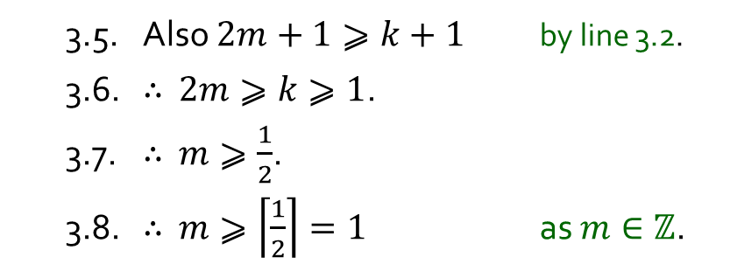
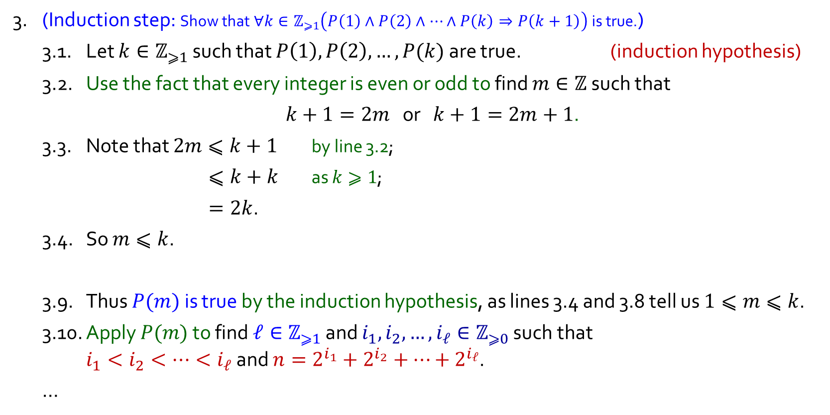
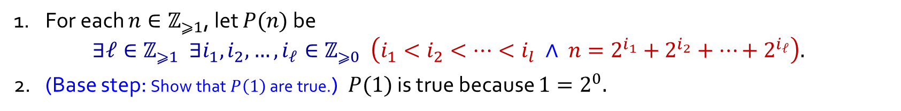
Q6.
Using Strong MI
1. For each $n∈ℤ_{⩾1}$, let $P(n)$ be $∃ℓ∈ℤ_{⩾1} ∃i_{1},i_{2}, …,i_{ℓ}∈ℤ_{⩾0} \left(i_{1}<i_{2}<⋯<i_{l} ∧ {n=2}^{i_{1}}+2^{i_{2}}+⋯+2^{i_{ℓ}}\right).$
2. (Base step: Show that $P\left(1\right)$ are true.) $P(1)$ is true because $1=2^{0}.$
3. (Induction step: Show that $∀k∈ℤ_{⩾1}\left(P\left(1\right)∧P\left(2\right)∧⋯∧P\left(k\right)⇒P\left(k+1\right)\right)$ is true.)
3.1. Let $k∈ℤ_{⩾1}$ such that $P\left(1\right),P\left(2\right),…,P(k)$are true. (induction hypothesis)
3.2. Use the fact that every integer is even or odd to find $m∈ℤ$ such that
$k+1=2m$ or $k+1=2m+1$.
3.3. Note that $2m⩽k+1$ by line 3.2;
$⩽k+k$ as $k⩾1$;
$=2k$.
3.4. So $m⩽k$.
3.9. Thus $P(m)$ is true by the induction hypothesis, as lines 3.4 and 3.8 tell us $1⩽m⩽k$.
3.10. Apply $P(m)$ to find $ℓ∈ℤ_{⩾1}$ and $i_{1},i_{2}, …,i_{ℓ}∈ℤ_{⩾0}$ such that $i_{1}<i_{2}<⋯<i_{ℓ}$ and ${n=2}^{i_{1}}+2^{i_{2}}+⋯+2^{i_{ℓ}}$.
…
3.5. Also $2m+1⩾k+1$ by line 3.2.
3.6. $∴$ $2m⩾k⩾1$.
3.7. $∴$ $m⩾\frac{1}{2}$.
3.8. $∴$ $m⩾\left\lceil \frac{1}{2}\right\rceil =1$ as $m∈ℤ$.

Slide 18


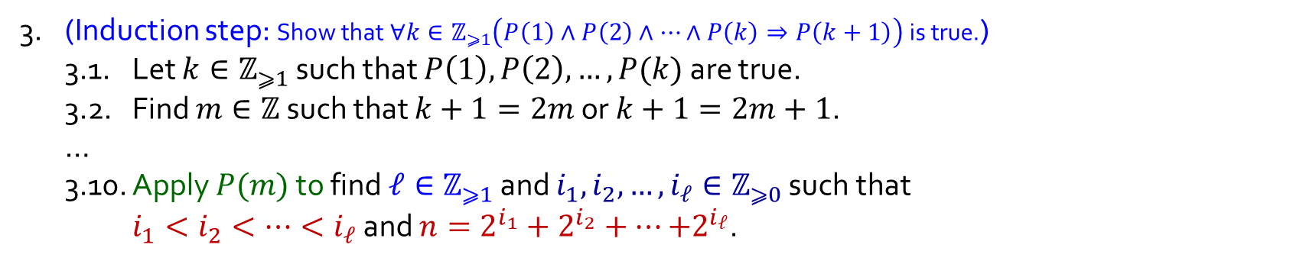
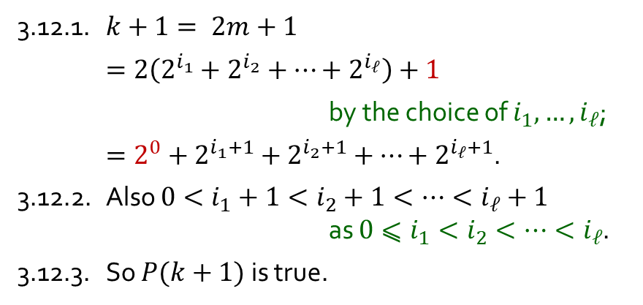

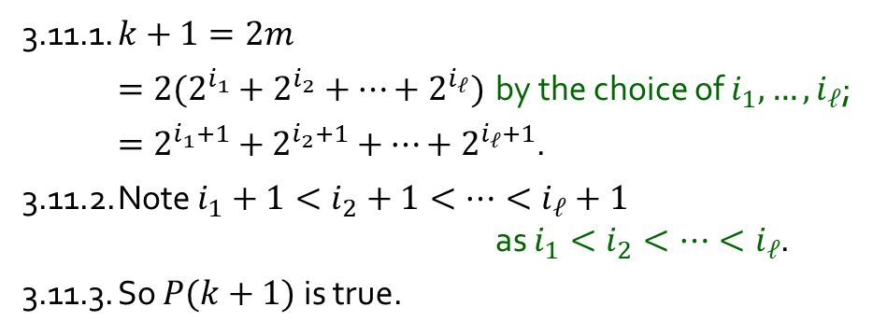
Q6.
Using Strong MI
1. For each $n∈ℤ_{⩾1}$, let $P(n)$ be $∃ℓ∈ℤ_{⩾1} ∃i_{1},i_{2}, …,i_{ℓ}∈ℤ_{⩾0} \left(i_{1}<i_{2}<⋯<i_{l} ∧ {n=2}^{i_{1}}+2^{i_{2}}+⋯+2^{i_{ℓ}}\right).$
2. (Base step: Show that $P\left(1\right)$ are true.) $P(1)$ is true because $1=2^{0}.$
3. (Induction step: Show that $∀k∈ℤ_{⩾1}\left(P\left(1\right)∧P\left(2\right)∧⋯∧P\left(k\right)⇒P\left(k+1\right)\right)$ is true.)
3.1. Let $k∈ℤ_{⩾1}$ such that $P\left(1\right),P\left(2\right),…,P(k)$are true.
3.2. Find $m∈ℤ$ such that $k+1=2m$ or $k+1=2m+1$.
…
3.10. Apply $P(m)$ to find $ℓ∈ℤ_{⩾1}$ and $i_{1},i_{2}, …,i_{ℓ}∈ℤ_{⩾0}$ such that $i_{1}<i_{2}<⋯<i_{ℓ}$ and ${n=2}^{i_{1}}+2^{i_{2}}+⋯{+2}^{i_{ℓ}}$.
3.11. Case 1$: k+1 = 2m$.
3.12. Case 2$: k+1 = 2m+1$.
3.11.1. $k+1=2m$
$=2(2^{i_{1}}+2^{i_{2}}+⋯+2^{i_{ℓ}})$ by the choice of $i_{1},…,i_{ℓ}$;
$=2^{i_{1}+1}+2^{i_{2}+1}+⋯+2^{i_{ℓ}+1}$.
3.11.2. Note $i_{1}+1<i_{2}+1<⋯<i_{ℓ}+1$ as $i_{1}<i_{2}<⋯<i_{ℓ}$.
3.11.3. So $P(k+1)$ is true.
3.12.1. $k+1= 2m+1$
$=2\left(2^{i_{1}}+2^{i_{2}}+⋯+2^{i_{ℓ}}\right)+1$
by the choice of $i_{1},…,i_{ℓ}$;
$=2^{0}+2^{i_{1}+1}+2^{i_{2}+1}+⋯+2^{i_{ℓ}+1}$.
3.12.2. Also ${0<i}_{1}+1<i_{2}+1<⋯<i_{ℓ}+1$ as $0⩽i_{1}<i_{2}<⋯<i_{ℓ}$.
3.12.3. So $P(k+1)$ is true.
3.13. Thus $P(k+1)$ is true in all cases.
4. Hence $∀n∈ℤ_{⩾1} P(n)$ is true by Strong MI.

Slide 19
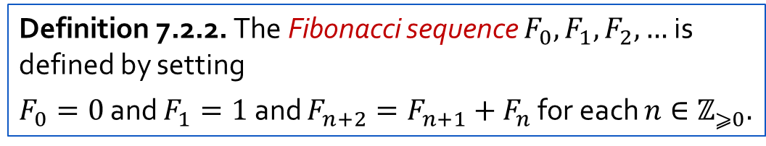
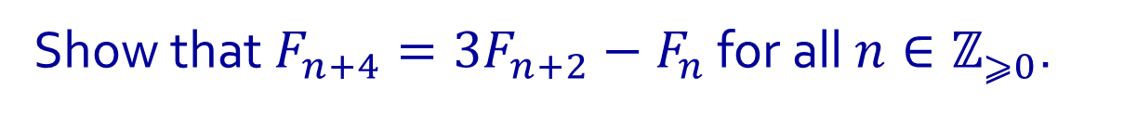
Q7.
Show that $F_{n+4}=3F_{n+2}−F_{n}$ for all $n∈ℤ_{⩾0}$.
Definition 7.2.2. The Fibonacci sequence $F_{0},F_{1},F_{2},…$ is defined by setting
$F_{0}=0$ and $F_{1}=1$ and $F_{n+2}=F_{n+1}{+ F}_{n}$ for each $n∈ℤ_{⩾0}.$

Slide 20
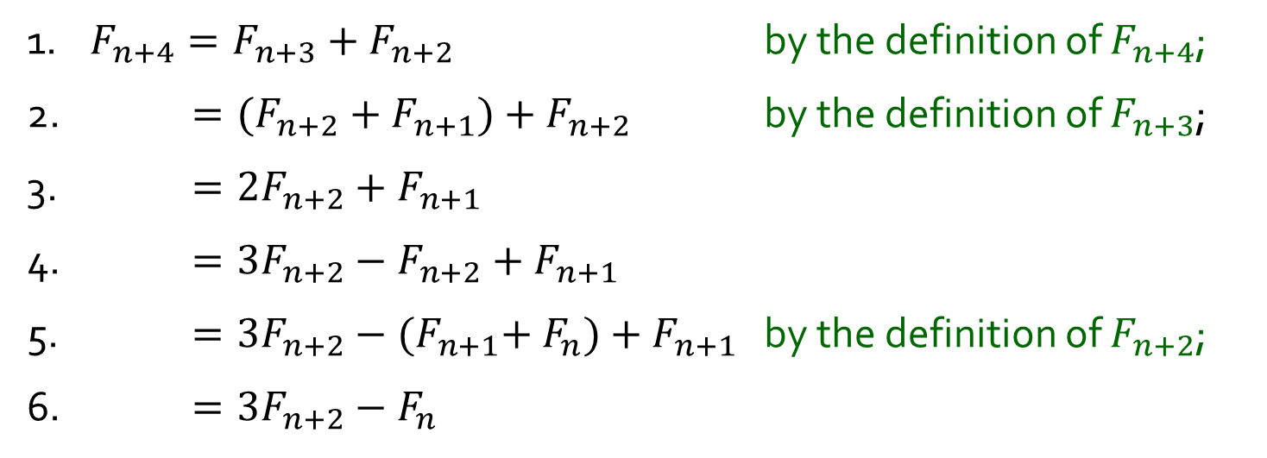
Q7.
Show that $F_{n+4}=3F_{n+2}−F_{n}$ for all $n∈ℤ_{⩾0}$.
1. $F_{n+4}=F_{n+3}+F_{n+2}$ by the definition of $F_{n+4}$;
2. $=(F_{n+2}+F_{n+1})+F_{n+2}$ by the definition of $F_{n+3}$;
3. $=2F_{n+2}+F_{n+1}$
4. $=3F_{n+2}−F_{n+2}+F_{n+1}$
5. $=3F_{n+2}−{(F}_{n+1}+ F_{n})+F_{n+1}$ by the definition of $F_{n+2}$;
6. $=3F_{n+2}−F_{n}$
Definition 7.2.2. The Fibonacci sequence $F_{0},F_{1},F_{2},…$ is defined by setting
$F_{0}=0$ and $F_{1}=1$ and $F_{n+2}=F_{n+1}{+ F}_{n}$ for each $n∈ℤ_{⩾0}.$

Slide 21
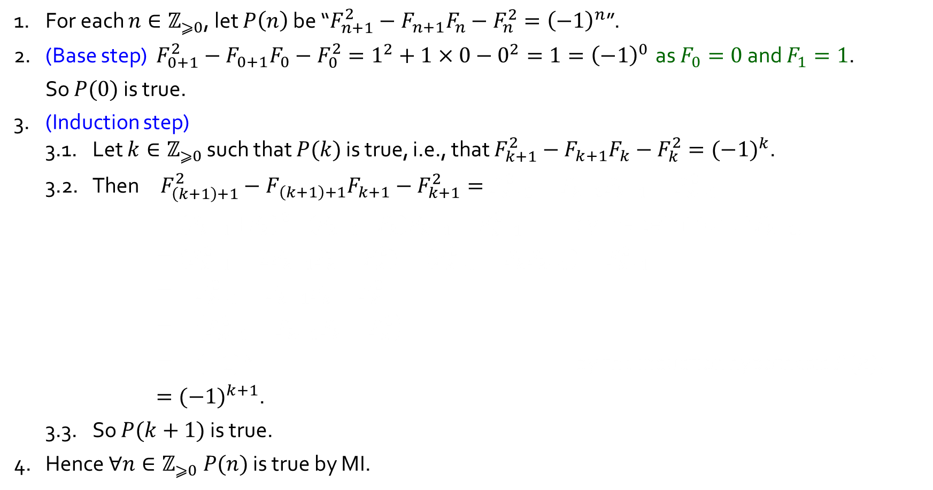
Q8.
Show that $F_{n+1}^{2}−F_{n+1}F_{n}−F_{n}^{2}={(−1)}^{n}$ for all $n∈ℤ_{⩾0}$.
1. For each $n∈ℤ_{⩾0}$, let $P\left(n\right)$ be “$F_{n+1}^{2}−F_{n+1}F_{n}−F_{n}^{2}={\left(−1\right)}^{n}$”.
2. (Base step) $F_{0+1}^{2}−F_{0+1}F_{0}−F_{0}^{2}=1^{2}+1×0−0^{2}=1={\left(−1\right)}^{0}$ as $F_{0}=0$ and $F_{1}=1$.
So $P(0)$ is true.
3. (Induction step)
3.1. Let $k∈ℤ_{⩾0}$ such that $P(k)$ is true, i.e., that $F_{k+1}^{2}−F_{k+1}F_{k}−F_{k}^{2}={(−1)}^{k}$.
3.2. Then $F_{\left(k+1\right)+1}^{2}−F_{\left(k+1\right)+1}F_{k+1}−F_{k+1}^{2}=F_{k+2}^{2}−F_{k+2}F_{k+1}−F_{k+1}^{2}$
$={(F_{k+1}{+F}_{k})}^{2}−{(F}_{k+1}{+F}_{k})F_{k+1}−F_{k+1}^{2}$ by the definition of $F_{k+2}$;
$=(F_{k+1}^{2}+2F_{k+1}F_{k}+F_{k}^{2})−(F_{k+1}^{2}+F_{k}F_{k+1})−F_{k+1}^{2}$
$={−F}_{k+1}^{2}+F_{k+1}F_{k}+F_{k}^{2}$
$=−\left(F_{k+1}^{2}−F_{k+1}F_{k}−F_{k}^{2}\right)$
$=−{(−1)}^{k}$ by the induction hypothesis $P(k)$;
$={(−1)}^{k+1}$.
3.3. So $P(k+1)$ is true.
4. Hence $∀n∈ℤ_{⩾0} P(n)$ is true by MI.
Definition 7.2.2. The Fibonacci sequence $F_{0},F_{1},F_{2},…$ is defined by setting
$F_{0}=0$ and $F_{1}=1$ and $F_{n+2}=F_{n+1}{+ F}_{n}$ for each $n∈ℤ_{⩾0}.$

Slide 22
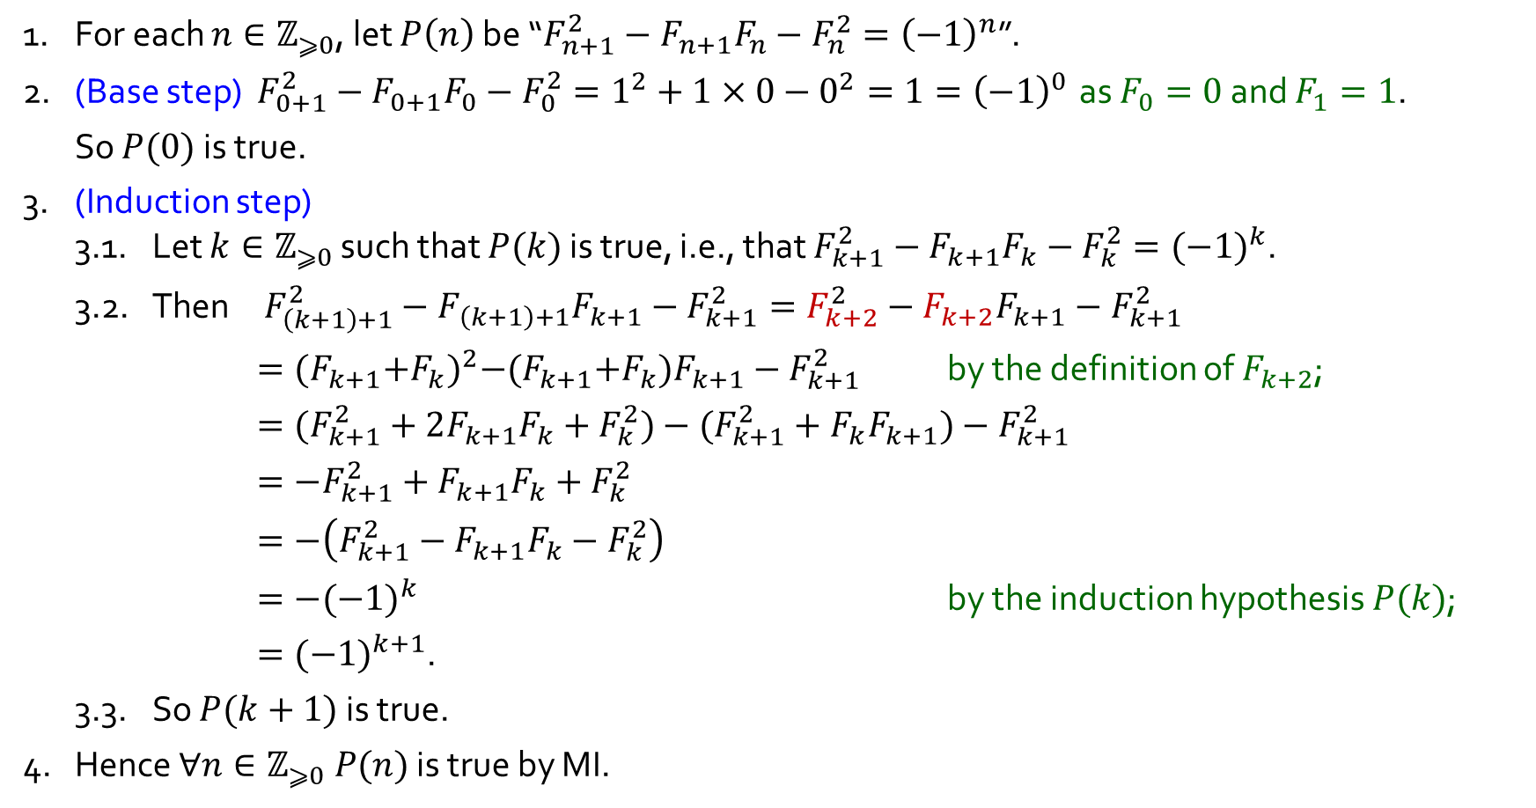
Q8.
Show that $F_{n+1}^{2}−F_{n+1}F_{n}−F_{n}^{2}={(−1)}^{n}$ for all $n∈ℤ_{⩾0}$.
1. For each $n∈ℤ_{⩾0}$, let $P\left(n\right)$ be “$F_{n+1}^{2}−F_{n+1}F_{n}−F_{n}^{2}={\left(−1\right)}^{n}$”.
2. (Base step) $F_{0+1}^{2}−F_{0+1}F_{0}−F_{0}^{2}=1^{2}+1×0−0^{2}=1={\left(−1\right)}^{0}$ as $F_{0}=0$ and $F_{1}=1$.
So $P(0)$ is true.
3. (Induction step)
3.1. Let $k∈ℤ_{⩾0}$ such that $P(k)$ is true, i.e., that $F_{k+1}^{2}−F_{k+1}F_{k}−F_{k}^{2}={(−1)}^{k}$.
3.2. Then $F_{\left(k+1\right)+1}^{2}−F_{\left(k+1\right)+1}F_{k+1}−F_{k+1}^{2}=F_{k+2}^{2}−F_{k+2}F_{k+1}−F_{k+1}^{2}$
$={(F_{k+1}{+F}_{k})}^{2}−{(F}_{k+1}{+F}_{k})F_{k+1}−F_{k+1}^{2}$ by the definition of $F_{k+2}$;
$=(F_{k+1}^{2}+2F_{k+1}F_{k}+F_{k}^{2})−(F_{k+1}^{2}+F_{k}F_{k+1})−F_{k+1}^{2}$
$={−F}_{k+1}^{2}+F_{k+1}F_{k}+F_{k}^{2}$
$=−\left(F_{k+1}^{2}−F_{k+1}F_{k}−F_{k}^{2}\right)$
$=−{(−1)}^{k}$ by the induction hypothesis $P(k)$;
$={(−1)}^{k+1}$.
3.3. So $P(k+1)$ is true.
4. Hence $∀n∈ℤ_{⩾0} P(n)$ is true by MI.
Definition 7.2.2. The Fibonacci sequence $F_{0},F_{1},F_{2},…$ is defined by setting
$F_{0}=0$ and $F_{1}=1$ and $F_{n+2}=F_{n+1}{+ F}_{n}$ for each $n∈ℤ_{⩾0}.$

Slide 23
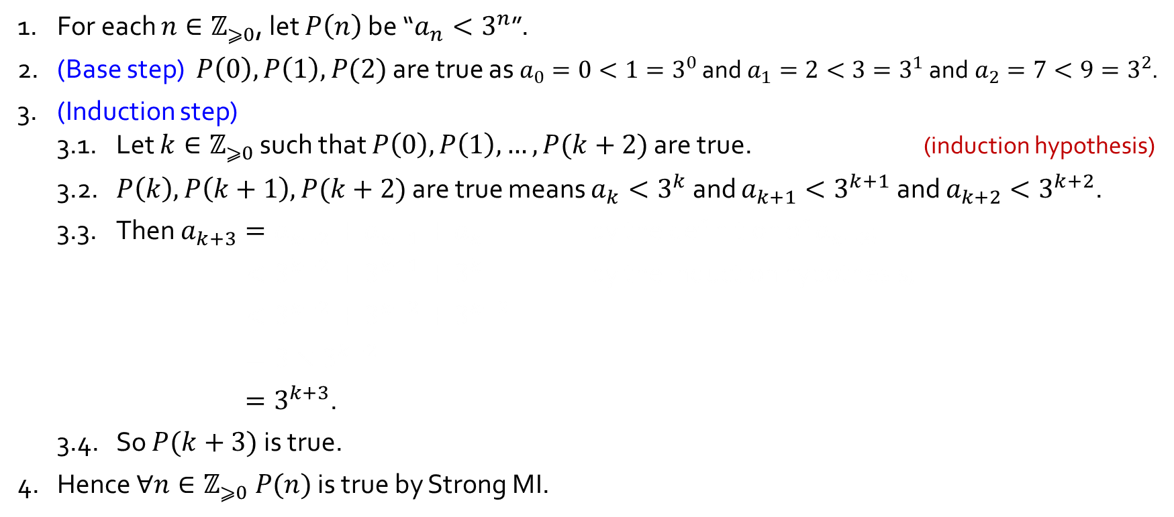
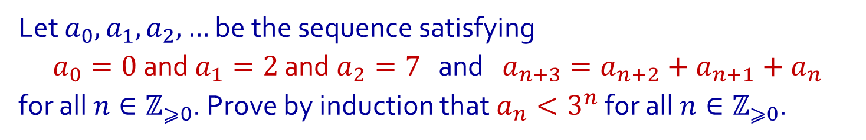
Q9.
Using Strong MI
Let $a_{0},a_{1},a_{2},…$ be the sequence satisfying
$a_{0}=0$ and $a_{1}=2$ and $a_{2}=7$ and $a_{n+3}=a_{n+2}+a_{n+1}+a_{n}$
for all $n∈ℤ_{⩾0}$. Prove by induction that $a_{n}<3^{n}$ for all $n∈ℤ_{⩾0}$.
1. For each $n∈ℤ_{⩾0}$, let $P\left(n\right)$ be “$a_{n}<3^{n}$”.
2. (Base step) $P\left(0\right),P\left(1\right),P(2)$ are true as $a_{0}=0<1=3^{0}$ and$a_{1}=2<3=3^{1}$ and$a_{2}=7<9=3^{2}$.
3. (Induction step)
3.1. Let $k∈ℤ_{⩾0}$ such that $P\left(0\right),P\left(1\right),…,P(k+2)$ are true. (induction hypothesis)
3.2. $P\left(k\right),P\left(k+1\right),P(k+2)$ are true means $a_{k}<3^{k}$ and $a_{k+1}<3^{k+1}$ and $a_{k+2}<3^{k+2}$.
3.3. Then $a_{k+3}=a_{k+2}+a_{k+1}+a_{k}$ by the definition of $a_{k+3}$;
$<3^{k+2}+3^{k+1}+3^{k}$ by the induction hypothesis;
$<3^{k+2}+3^{k+2}+3^{k+2}$
$=3×3^{k+2}$
$=3^{k+3}$.
3.4. So $P(k+3)$ is true.
4. Hence $∀n∈ℤ_{⩾0} P(n)$ is true by Strong MI.

Slide 24

Q9.
Using Strong MI
Let $a_{0},a_{1},a_{2},…$ be the sequence satisfying
$a_{0}=0$ and $a_{1}=2$ and $a_{2}=7$ and $a_{n+3}=a_{n+2}+a_{n+1}+a_{n}$
for all $n∈ℤ_{⩾0}$. Prove by induction that $a_{n}<3^{n}$ for all $n∈ℤ_{⩾0}$.
1. For each $n∈ℤ_{⩾0}$, let $P\left(n\right)$ be “$a_{n}<3^{n}$”.
2. (Base step) $P\left(0\right),P\left(1\right),P(2)$ are true as $a_{0}=0<1=3^{0}$ and$a_{1}=2<3=3^{1}$ and$a_{2}=7<9=3^{2}$.
3. (Induction step)
3.1. Let $k∈ℤ_{⩾0}$ such that $P\left(0\right),P\left(1\right),…,P(k+2)$ are true. (induction hypothesis)
3.2. $P\left(k\right),P\left(k+1\right),P(k+2)$ are true means $a_{k}<3^{k}$ and $a_{k+1}<3^{k+1}$ and $a_{k+2}<3^{k+2}$.
3.3. Then $a_{k+3}=a_{k+2}+a_{k+1}+a_{k}$ by the definition of $a_{k+3}$;
$<3^{k+2}+3^{k+1}+3^{k}$ by the induction hypothesis;
$<3^{k+2}+3^{k+2}+3^{k+2}$
$=3×3^{k+2}$
$=3^{k+3}$.
3.4. So $P(k+3)$ is true.
4. Hence $∀n∈ℤ_{⩾0} P(n)$ is true by Strong MI.

Slide 25
















Q10.
Define a set $S$ recursively as follows:
(1) $2∈S.$ (base clause)
(2) If $x∈S$, then $3x∈S$ and $x^{2}∈S$. (recursion clause)
(3) Membership for $S$ can always be demonstrated by (finitely many) successive applications of clauses above. (minimality clause)
Which of the numbers $0, 6, 15, 16, 36$ are in $S$? Which are not?
18
$$3x$$
$$3x$$
$$x^{2}$$
6
$$x^{2}$$
36
$$3x$$
$$3x$$
$$x^{2}$$
2
$$x^{2}$$
12
$$3x$$
4
$$3x$$
$$x^{2}$$
$$x^{2}$$
16
$$3x$$
$$x^{2}$$

Slide 26





Q10.
Define a set $S$ recursively as follows:
(1) $2∈S.$ (base clause)
(2) If $x∈S$, then $3x∈S$ and $x^{2}∈S$. (recursion clause)
(3) Membership for $S$ can always be demonstrated by (finitely many) successive applications of clauses above. (minimality clause)
Which of the numbers $0, 6, 15, 16, 36$ are in $S$? Which are not?
Structural induction over $S$.
To prove that $∀n∈S P(n)$ is true, where each $P(n)$is a proposition, it suffices to:
(base step) show that $P(2)$ is true; and
(induction step) show that $∀x∈S \left(P\left(x\right)⇒P(3x)∧P(x^{2})\right)$ is true.
$$x$$ | $$x∈S$$
0
6
15
16
36
✘
✓
We know $0∉S$ because all $x∈S$ satisfy $x⩾2$, as one can show by structural induction over $S$.
✘
$2∈S$ by the base clause.
$∴6∈S$ by the recursion clause ($3x∈S$ with $x=2$) and the previous line.
$∴36∈S$ by the recursion clause ($x^{2}∈S$ with $x=6$) and the previous line.
✓
✓
$2∈S$ by the base clause.
$∴4∈S$ by the recursion clause ($x^{2}∈S$ with $x=2$) and the previous line.
$∴16∈S$ by the recursion clause ($x^{2}∈S$ with $x=4$) and the previous line.
We know $15∉S$ because no $x∈S$ is odd, as one can show by structural induction over $S$.

